Slide 1
Discussion 3: Linked Lists, Arrays

Slide 2
Agenda
Administrivia
Review of SLLists
SLList problems
Review of arrays
Array problems

Slide 3
Preface
Lots of questions on the discussion today. These are for practice! We will not be able to get through all of them.

Slide 4
Administrivia
Attendance: tinyurl.com/disc3-cz
Project 1A due this Friday!
Implementing deque interface, highly recommend to use Java Visualizer
Start early!
LOST sections are now available Tues 5-6PM 187 Dwinelle
If you haven’t been to lecture/are lost and want a high-level review
Daytime office hours has been moved to 109 Morgan. See calendar on course website for details.
The SLC is now available for open studying! Drop by M-W 11-3 to study with your peers!
Online sections are also going to be made available (Most likely Tuesday nights). Check Piazza for more details.
CSM sign-ups will open Friday night! Opportunity to get extra help in a small-group setting with a mentor.
For the quizzes, make sure to bubble a single bubble completely and clearly. Do not use check marks or bubble multiple bubbles.

Slide 5

Review: SLList
5
10
15
class that hides the internals of linked lists using encapsulation
allows us to hide the inner workings of the linked list and store meta-information about the list as a whole (ex. size)
Analogy: You refer to a train as a whole, not as individual cars. In the same way, instead of just having the raw links with first and next, you refer to it as a whole.

Slide 6
Review: SLList Diagram
We add a size variable so we don’t have to step through the entire linked list every time we want the size
x
“First” is a pointer to the first link in the linked list.
addFirst()
size
first
getFirst()
3
We add these methods to abstract away the mechanics of adding items to, and getting items from, our list
addLast()
size()
5
10
15
item
next

Slide 7
Review: Sentinel Nodes
Question: How do we represent an empty linked list? Set first to null?
This leads ugly code, as we will have to add a bunch of null checks to code that handles the list.
For example, addLast would need a special case for if the list is null
Goal of sentinel: make code as simple and generic as possible so no special cases
sentinel: a “dummy” node that doesn’t hold any important info, just a placeholder to help us avoid null checks

Slide 8
Review: Sentinel Node Diagram
addFirst()
size
first
getFirst()
Instead of pointing to null, first points to the sentinel node.
0
addLast()
size()
??
item
next
The sentinel is not included in the size
addFirst()
size
first
getFirst()
3
addLast()
size()
??
5
10
15
item
next

Slide 9
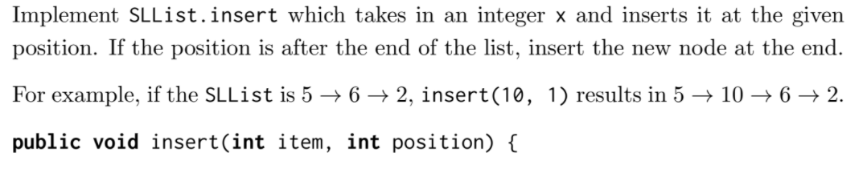
Exercise 1: insert
First, think about what types of things we need to check for.
How do we get to the specified position?
After we get there, how can we re-assign pointers such that we add the new node?

Slide 10
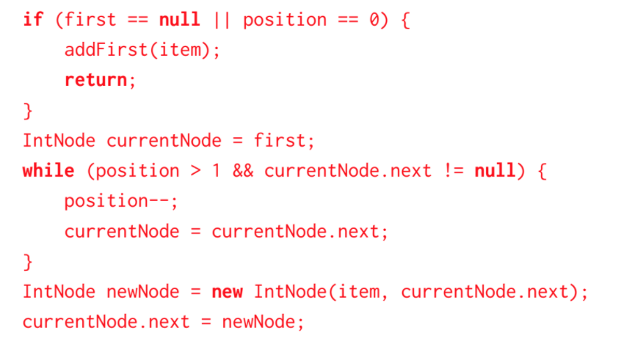
Exercise 1: insert

Slide 11
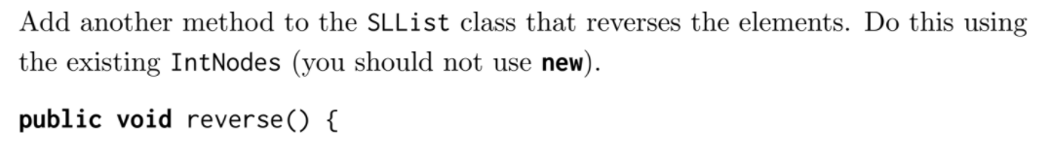
Exercise 2: reverse

Slide 12
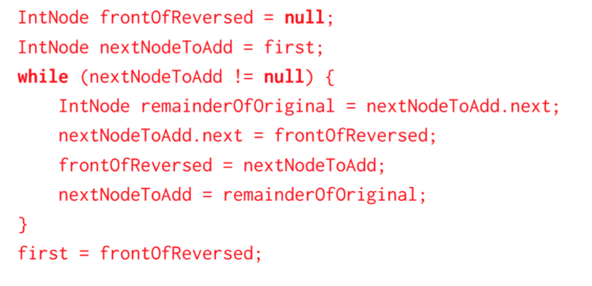
Exercise 2: reverse

Slide 13
Review: DLLists
One thing that a list should support is remove(int i) which removes an element at position i.
With our brand new SLList with sentinel, what would we have to do to remove a link?
Notes:
Having the extra arrows does increase the amount of memory you use.

Slide 14
Review: DLLists
One thing that a list should support is remove(int i) which removes an element at position i.
With our brand new SLList with sentinel, what would we have to do to remove a link?
. . .
5
10
15
Say we want to remove this node
Notes:
Having the extra arrows does increase the amount of memory you use.

Slide 15
Review: DLLists
One thing that a list should support is remove(int i) which removes an element at position i.
With our brand new SLList with sentinel, what would we have to do to remove a link?
. . .
5
10
15
1. We need to jump to that link
Notes:
Having the extra arrows does increase the amount of memory you use.

Slide 16
Review: DLLists
One thing that a list should support is remove(int i) which removes an element at position i.
With our brand new SLList with sentinel, what would we have to do to remove a link?
. . .
5
10
15
2.Save a reference to this node (If we don’t, we will lose it forever! We need it later)
Notes:
Having the extra arrows does increase the amount of memory you use.

Slide 17
Review: DLLists
One thing that a list should support is remove(int i) which removes an element at position i.
With our brand new SLList with sentinel, what would we have to do to remove a link?
. . .
5
10
15
3.Remove its “next” pointer
Notes:
Having the extra arrows does increase the amount of memory you use.

Slide 18
Review: DLLists
One thing that a list should support is remove(int i) which removes an element at position i.
With our brand new SLList with sentinel, what would we have to do to remove a link?
. . .
5
10
15
4.Jump to the node before
Notes:
Having the extra arrows does increase the amount of memory you use.

Slide 19
Review: DLLists
One thing that a list should support is remove(int i) which removes an element at position i.
With our brand new SLList with sentinel, what would we have to do to remove a link?
. . .
5
10
15
5.Reassign next to the node after
Notes:
Having the extra arrows does increase the amount of memory you use.

Slide 20
Review: DLLists
had to traverse the list TWICE, inefficient.
Instead of just “next” link pointers, we add “previous” link pointers too
Can traverse the list forwards and backwards
5
10
15
Notes:
Having the extra arrows does increase the amount of memory you use.

Slide 21
Review: ALists
Long time to traverse the DLList (have to traverse the whole structure)
What about arrays?
Constant time access!
Can’t resize easily
Let’s try this instead: AList
underlying structure is an array
Create a resize function so we can support adding/removing
Utilize geometric resizing
Copy all items from the old array into new array

Slide 22
Exercise 3: Array insert
Consider a method that inserts item into array arr at the given position. The method should return the resulting array. For example, if x = [5, 9, 14, 15], item = 6, and position = 2, then the method should return [5, 9, 6, 14, 15]. If position is past the end of the array, insert item at the end of the array. Is it possible to write a version of this method that returns void and changes arr in place (i.e., destructively)?

Slide 23
Exercise 3: Array insert
Consider a method that inserts item into array arr at the given position. The method should return the resulting array. For example, if x = [5, 9, 14, 15], item = 6, and position = 2, then the method should return [5, 9, 6, 14, 15]. If position is past the end of the array, insert item at the end of the array. Is it possible to write a version of this method that returns void and changes arr in place (i.e., destructively)?
No, because we would need to create a bigger array which means not changing arr in place.

Slide 24
Exercise 4: Array reverse
Consider a method that destructively reverses the items in arr. For example calling reverse on an array [1, 2, 3] should change the array to be [3, 2, 1]. What is the fewest number of iteration steps you need? What is the fewest number of additional variables you need?

Slide 25
Exercise 4: Array reverse
Consider a method that destructively reverses the items in arr. For example calling reverse on an array [1, 2, 3] should change the array to be [3, 2, 1]. What is the fewest number of iteration steps you need? What is the fewest number of additional variables you need?
Half the length of the array. You can swap the two paired indices at the same step. One additional variable as a temporary buffer during the swap; one index for the iteration. More may make your code neater.

Slide 26
Exercise 3: Array insert Extra
Write a method that inserts the item into the arr at the specified position. Positions are 0-indexed. If the position goes past the end of the array just insert it at the end.
public static int[] insert(int[] arr, int item, int position)
}

Slide 27
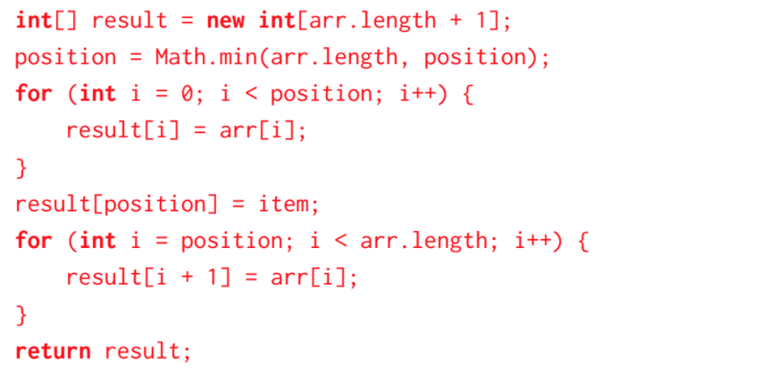
Exercise 3: Array insert Extra
Write a method that inserts the item into the arr at the specified position. Positions are 0-indexed. If the position goes past the end of the array just insert it at the end.
public static int[] insert(int[] arr, int item, int position)
}

Slide 28
Exercise 4: Array reverse Extra
Write a method that reverse the elements in an array destructively.
public static void reverse(int[] arr) {
}

Slide 29
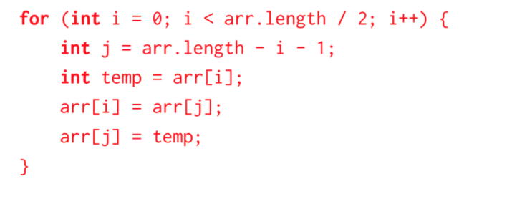
Exercise 4: Array reverse Extra
Write a method that reverse the elements in an array destructively.
public static void reverse(int[] arr) {
}

Slide 30
Exercise 5: Replicate Extra
Write a non-destructive method replicate(int[] arr) that replaces the number at index i with arr[i] copies of itself. For example, replicate([3, 2, 1]) would return [3, 3, 3, 2, 2, 1].
public static int[] replicate(int[] arr) {
}

Slide 31
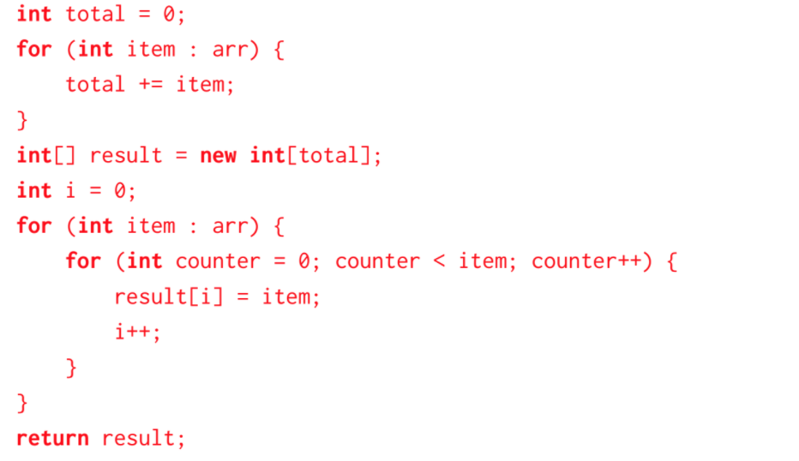
Exercise 5: Replicate Extra
Write a non-destructive method replicate(int[] arr) that replaces the number at index i with arr[i] copies of itself. For example, replicate([3, 2, 1]) would return [3, 3, 3, 2, 2, 1].
public static int[] replicate(int[] arr) {
}

